Slide 1

Hyperparameter Learning for Conditional Mean Embeddings with Rademacher Complexity Bounds
Kelvin Hsu, Richard Nock, Fabio Ramos
Notes:
Good morning everyone! I hope everyone is able to stay awake despite the crazy jet lag we are all having.

Slide 2
Hyperparameter Learning for Conditional Mean Embeddings with Rademacher Complexity Bounds
Kelvin Hsu, Richard Nock, Fabio Ramos
Why hyperparameter learning is such a critical problem for CMEs
Why conditional mean embeddings are naturally suited for probabilistic classification in a multiclass setting
How Rademacher complexity bounds help us address this problem
Notes:
Good morning everyone! I hope everyone is able to stay awake despite the crazy jet lag we are all having.
My name is Kelvin. My goal today is to have everyone appreciate why hyperparameter learning is such a critical problem for conditional mean embeddings, or CMEs, how conditional mean embeddings are naturally suited for multiclass probabilistic classification, and how Rademacher complexity bounds can help us address this problem.
In order to do this, I want to start off with a simple exercise!

Slide 3
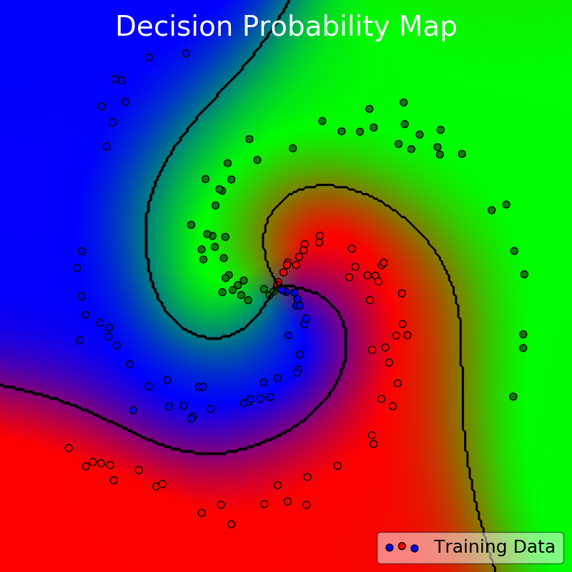
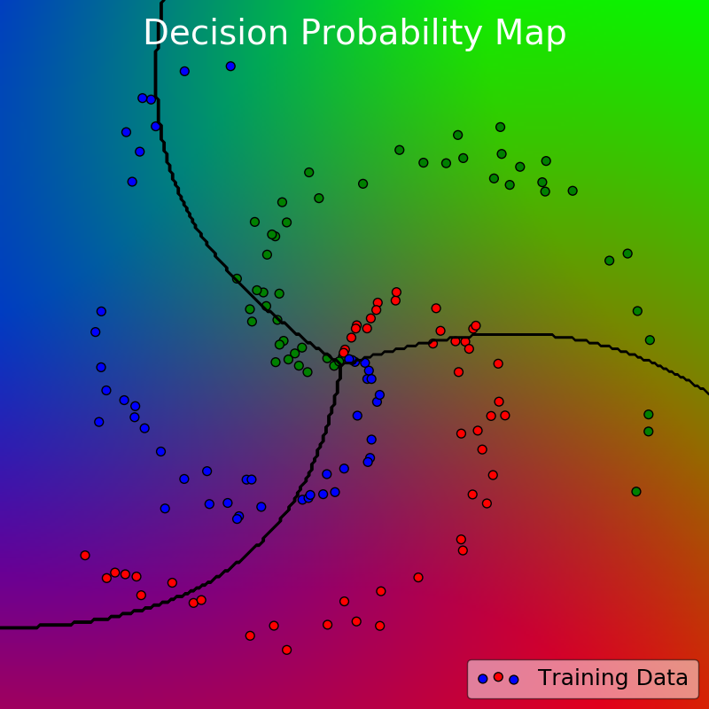
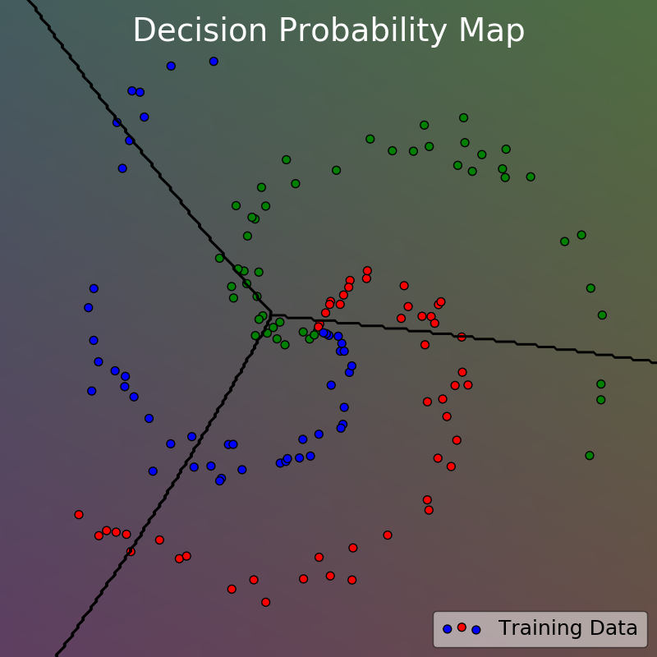
Which one is the best map?
A
B
C
Notes:
Suppose you are doing probabilistic classification in a multiclass setting, and you’re doing this in two dimensions. The scatter dots are our data, and the coloured map itself is the prediction or decision probability across the entire space. There are three classes in total (red, green, and blue), so that conveniently means I can use the three RGB colour channels to visualize the strength of each of the three decision probabilities with red, green, and blue.
Take a careful look at these three maps – A, B, and C, and I want you to pick the one you think that has the most appropriate fit. Which one of these would you rather have if you were to make a prediction map? This should be an easy one.

Slide 4

Which one is the best map?
A
B
C
Notes:
So if you picked anything other than A, you’re crazy ☺
Of course you’d pick A! It has the best fit to the data and the model seems to be at the right complexity to do the job.
So that was an easy one. Let’s do another one.

Slide 5
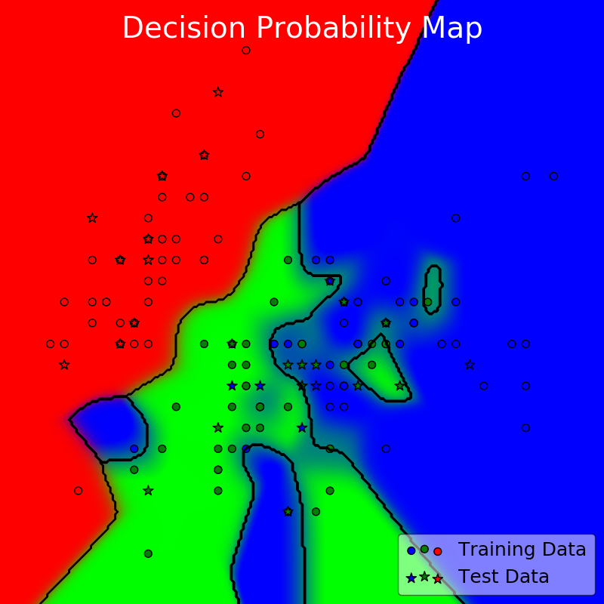
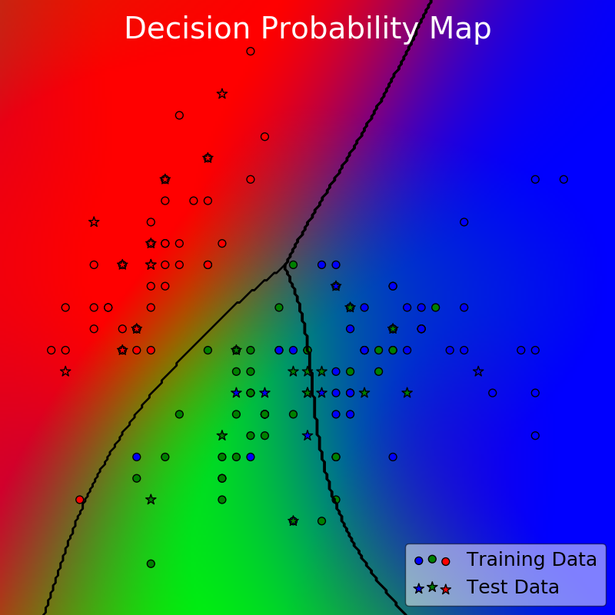
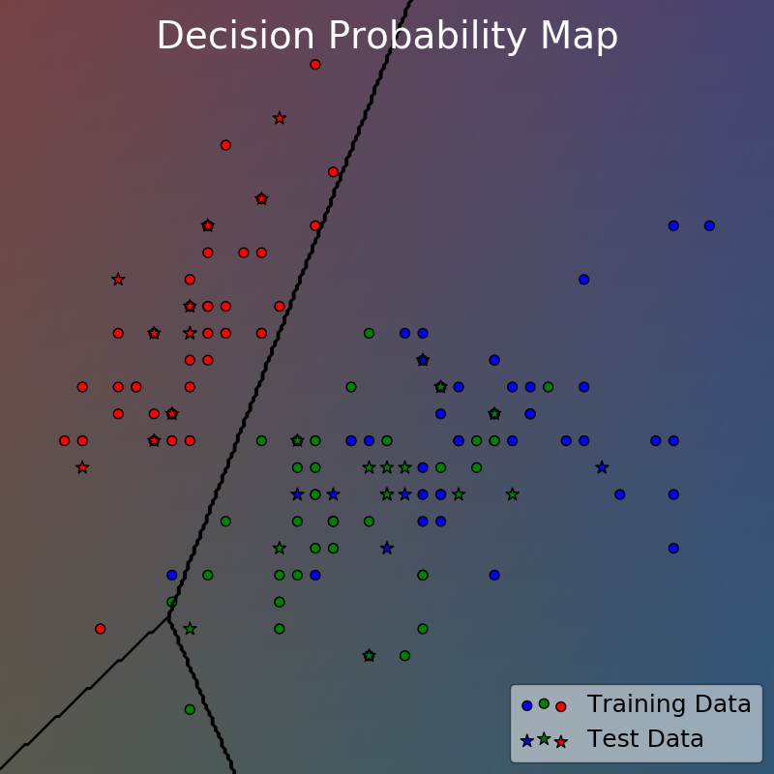
Which one is the best map?
A
B
C
What about this one?
Notes:
What about this one? This time I included both training and testing data. Training are circles, testing are stars. Which map would you rather have now? A, B, or C?

Slide 6
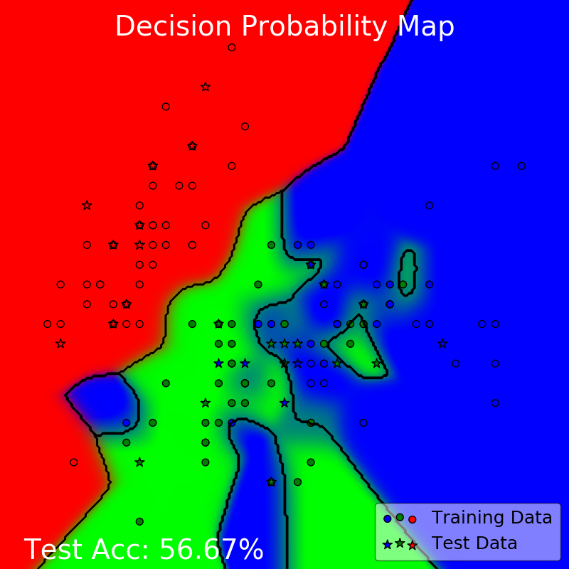
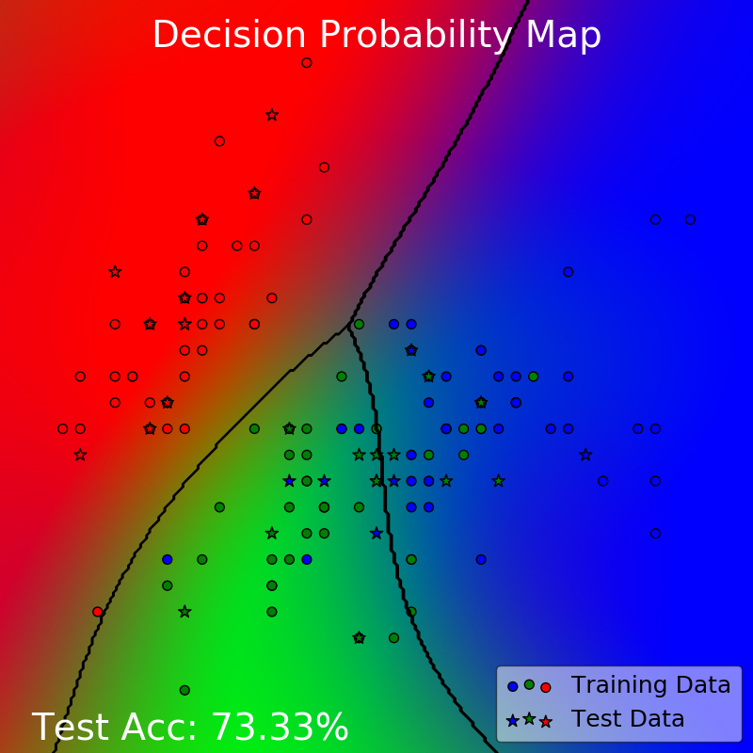
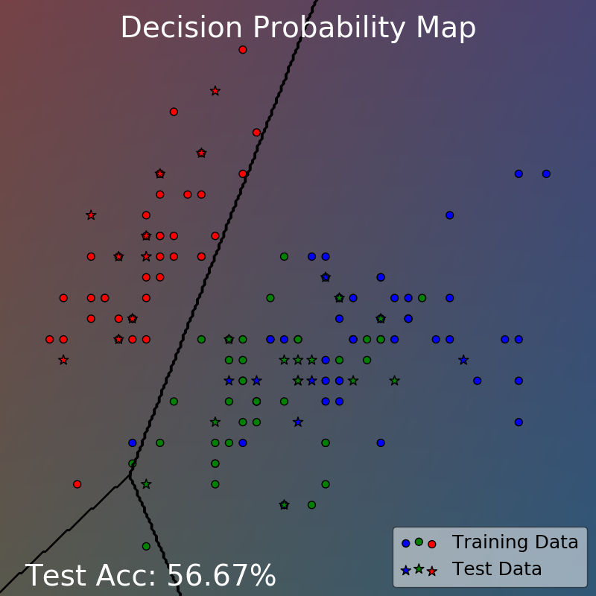
Which one is the best map?
A
B
C
The middle one has the best generalization in terms of test accuracy
Notes:
Definitely, it’s probably better to pick B this time, even though A fits the training data the best.
And this is because after all, what we care about is how well our model generalizes, and we use the accuracy on the test set (here) as a proxy to measure how well it generalizes.

Slide 7
Which one is the best map?
A
B
C
This is the first two attributes of iris
This dataset is actually not separable by any means!
The same point can have different labels!
Notes:
And some of you might recognize this dataset. It’s the standard iris dataset used in our favourite first year statistics class. You might remember that the original dataset is 4D, but if you take only the first 2 dimensions, the dataset is actually not separable by any means. The same point can have different labels! So, for this split of training and testing set, 73.33% is pretty much the best we can do in this dataset.

Slide 8
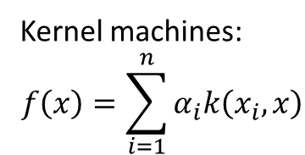
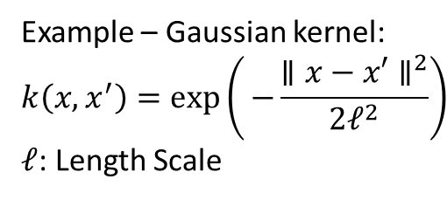
Which one is the best map?
Same kernel model – only the hyperparameters are different
Kernel machines:
$$f\left(x\right)=\sum_{i=1}^{n}{α_{i}k\left(x_{i},x\right)}$$
Example – Gaussian kernel:
$$k\left(x, x^{′}\right)=exp\left(⁡−\frac{{∥x−x′∥}^{2}}{2ℓ^{2}}\right)$$
$ℓ$: Length Scale
not trained by
the kernel machine
(hyperparameters)
trained by the kernel machine
(parameters)
Notes:
Now, in fact, the three decision probability maps actually came from the same kernel model. Sometimes we also call this the kernel machine.
So, what is a kernel machine? Most of the time, a kernel machine is a model whose predictions are a linear combination of kernels. And what are kernels? Kernels are symmetric functions of two variables that measure the similarity between two data points. The most common example that we often see is the Gaussian kernel given here.
For a kernel machine, the weights alpha are trained from data, usually by solving a linear set of equations of finding the solution a convex optimization problem. However, you can also see that the kernel itself has some parameters. Here, we have l for the length scale of the kernel. The tricky part is that these kernel parameters are inputs to the kernel algorithm and not learned by the kernel machine, which is why we call them hyperparameters.

Slide 9
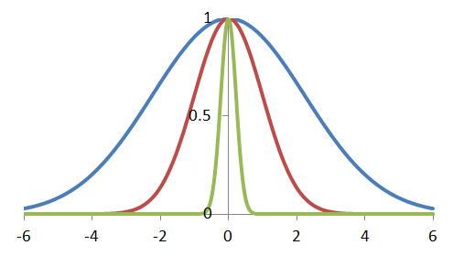
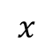
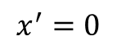
Which one is the best map?
Short Length Scale
Median Length Scale
Long Length Scale
Kernel machines:
$$f\left(x\right)=\sum_{i=1}^{n}{α_{i}k\left(x_{i},x\right)}$$
Example – Gaussian kernel:
$$k\left(x, x^{′}\right)=exp\left(⁡−\frac{{∥x−x′∥}^{2}}{2ℓ^{2}}\right)$$
$ℓ$: Length Scale
$$x^{′}=0$$
not trained by
the kernel machine
(hyperparameters)
trained by the kernel machine
(parameters)
$$x$$
Hyperparameter Learning for Conditional Mean Embeddings with Rademacher Complexity Bounds Kelvin Hsu, Richard Nock, and Fabio Ramos
Notes:
So what happens when we change those hyperparameters? For the Gaussian kernel, if you fix one of the inputs to zero, say x’, then we can visualize it like these curves here.
Length scales determine how distance is measured in a model. Short length scales on the left means our model can change its predictions more quickly as it moves across the space and long length scales on the right means our model changes its prediction more slowly as it moves across the space.
And there can be more types of hyperparameters. For example the conditional mean embedding has another hyperparameter for regularizing an inversion to make the computation more numerically stable. But whatever hyperparameters we might have, the point is that they govern how our model learns from the data, and changing them will result in very different models that we are seeing here.
So I know what you’re thinking…

Slide 10


Which one is the best map?
A
B
C
This is just Overfitting!
Notes:
This is just overfitting! Come on. Statistics 101.

Slide 11
Which one is the best map?
A
B
C
We already have a lot great ways to deal with this!
This is just Overfitting!
11 |
Hyperparameter Learning for Conditional Mean Embeddings with Rademacher Complexity Bounds Kelvin Hsu, Richard Nock, and Fabio Ramos
Notes:
We’ve dealt with this so many times already in machine learning. We already have a lot of great ways to deal with this!
You know, things like cross validation is like the go-to method for this problem and it’ll certainly work for conditional mean embeddings too!

Slide 12

Which one is the best map?
A
B
C
Right?
12 |
12 |
Hyperparameter Learning for Conditional Mean Embeddings with Rademacher Complexity Bounds Kelvin Hsu, Richard Nock, and Fabio Ramos
Hyperparameter Learning for Conditional Mean Embeddings with Rademacher Complexity Bounds Kelvin Hsu, Richard Nock, and Fabio Ramos
Notes:
Right?

Slide 13
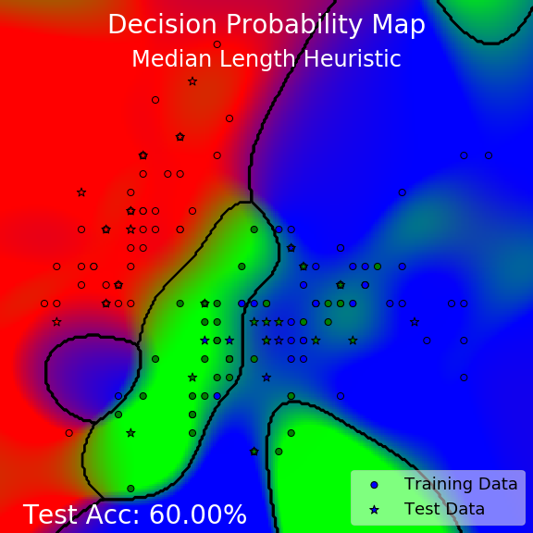
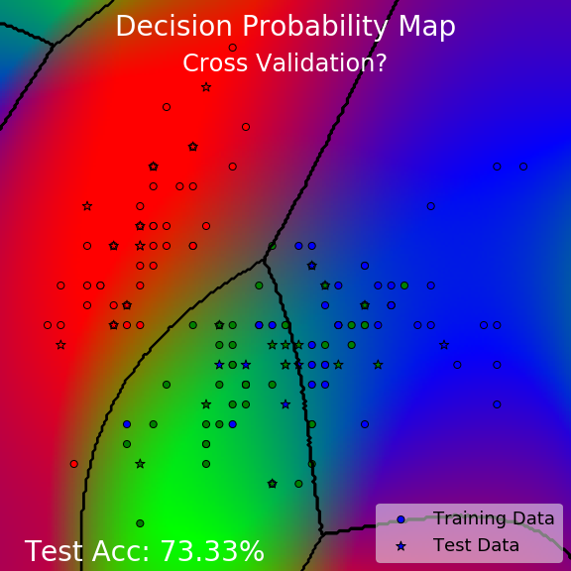
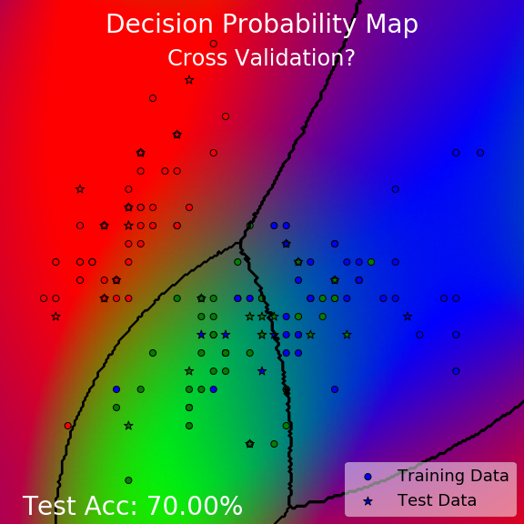

Current Methods for Hyperparameter Learning
D
E
F
No way…!
Notes:
Well… Unfortunately not!
Here are three decision probability maps obtained using current standard methods for hyperparameter learning.
On the left we have the commonly used median length heuristic used to set hyperparameters that have a length scale interpretation. The first problem is, well, it can only be used to set hyperparameters that are length scales, so things like regularisation hyperparameters are out the question. The second problem is, it makes no use of the target labels! So, unless you do something special, it never had the critical information that any learning algorithm would need to do well.
On the middle and right we have our favourite cross validation algorithm. You can see that they perform much better than the median length heuristic. In fact, the middle one achieves pretty much the same best test accuracy you could hope for here.
But, something feels a bit off. Can you see it? It’s the bit on the corners, where there are some unnatural patches of different classes appearing. There is nothing mysterious about it - this is happening simply because we are extrapolating to places where we do not have any data. Cross validation is based on minimizing the error on validation sets, and since there are no data points there for validation, it will not bother to do anything about those areas.
And you could argue that this is simply an extrapolation problem and since we do not have data at those far away regions it’s unfair to say the learning algorithm did a bad job at those area. But I would argue that for such a simple toy scenario, any reasonable pattern recognition learning algorithm should be able to generalize quite well beyond unseen regions with the simplest pattern.
And we know this is not the model’s problem. We know that a simple generalization is possible for a conditional mean embedding, because …

Slide 14

Current Methods for Hyperparameter Learning
D
E
F
No way…!
Hyperparameter Learning for Conditional Mean Embeddings with Rademacher Complexity Bounds Kelvin Hsu, Richard Nock, and Fabio Ramos
Notes:
… we have just seen this one doing just fine before! So it’s not that the class of model cannot represent this simple generalisation, but that the learning algorithm is unable to learn the right model.
Not only that, all of us here would know that cross validation has some standard major problems.

Slide 15

Current Methods for Hyperparameter Learning
How many folds? What seed?
Training multiple models… Expensive!
Notes:
How many folds do we use? 5? 10? 20?
And what seed do we use to randomize the split of the folds? Every time you use a different seed to split the data into folds, your end result is just going to be slightly different. This is why I showed two slightly different results here. They were the results of two different seeds.
And perhaps the most critical problem of all – it is really expensive! You have to retrain multiple models on the different folds and every model needs to access all the data points. For a standard conditional mean embedding, training each of these models has a cubic time complexity. It’s fine in a toy example like this, but it just doesn’t scale.

Slide 16
Current Methods for Hyperparameter Learning
How many folds? What seed?
Training multiple models… Expensive!
Current methods use mean square error (in the RKHS) Is that appropriate for classification?
Notes:
And also, I did not even mention the choice for the loss! What loss should we be minimizing for cross validation? For conditional mean embeddings, current methods effectively use a form of mean squared error, but in the reproducing kernel Hilbert space, which I will go through soon. Mean squared error may be suitable if your task is a regression task, but a natural question is: could there be other types of losses that are more effective for the purpose of generalizing our predictions in a classification scenario?

Slide 17
Current Methods for Hyperparameter Learning
We need a sense of model complexity
Current hyperparameter learning methods are too generic and not suited for CMEs!
Notes:
In summary, current hyperparameter learning methods are too generic and not suited for conditional mean embeddings.
As you can see from the cross validation example, just being good at predictions on validation sets are not enough, you need a sense of model complexity too.

Slide 18
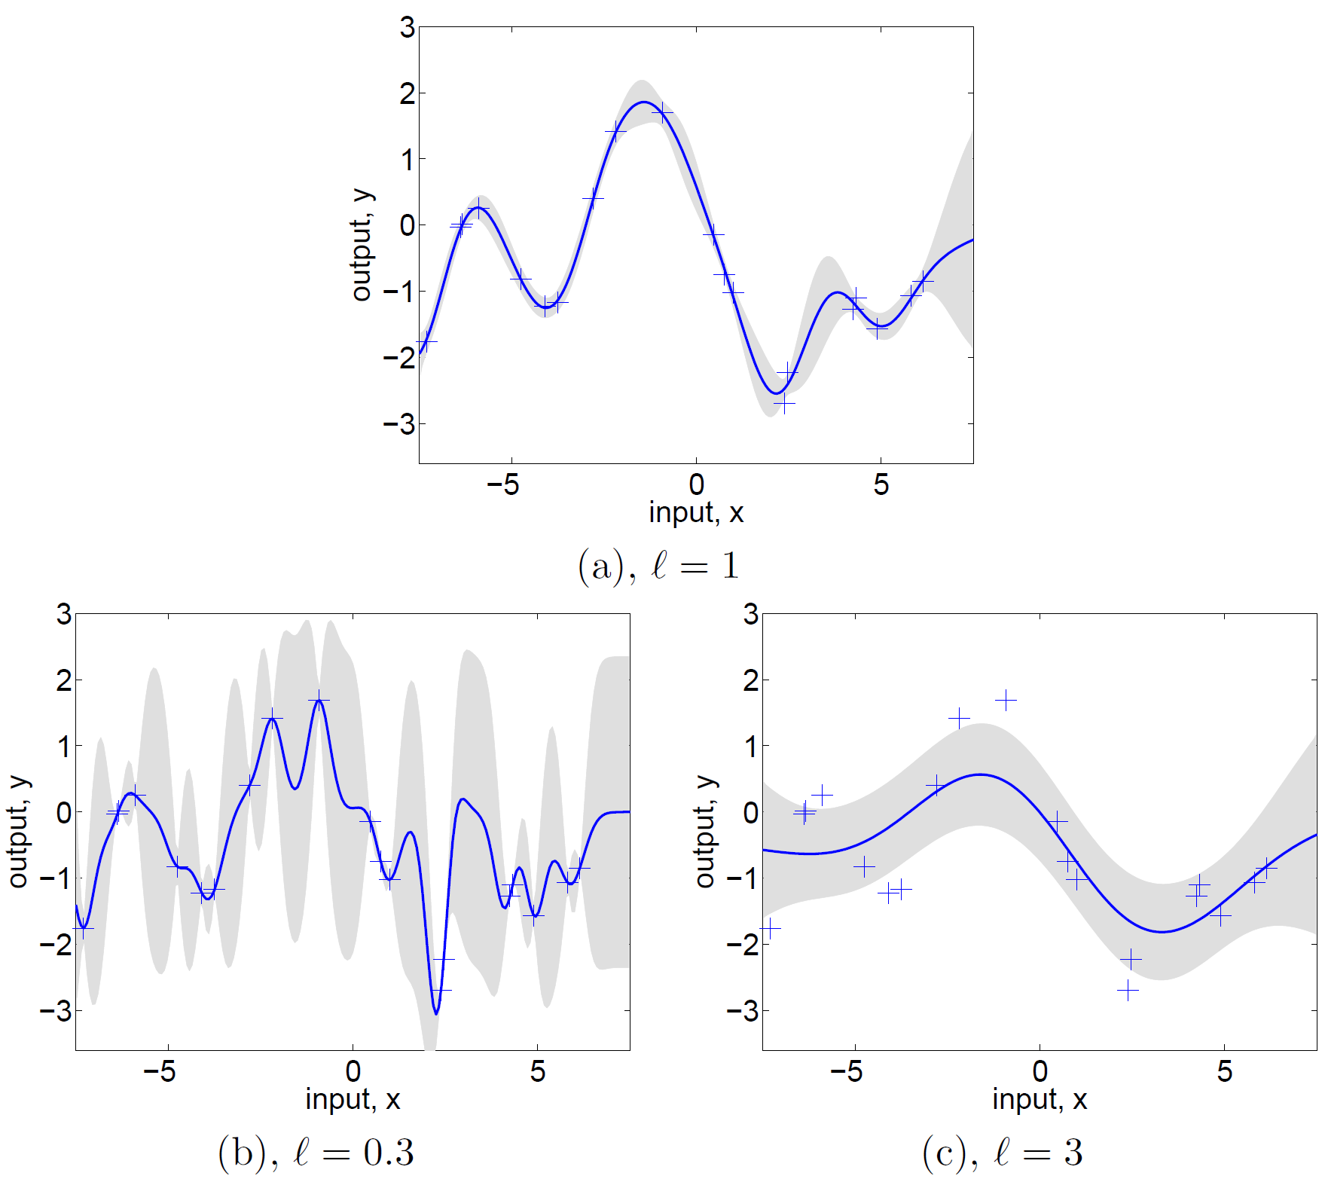
The envious success of Gaussian processes
Notes:
So with all these problems for hyperparameter learning in mind, I want to turn your attention to how Gaussian processes solve this problem.
Gaussian processes are also based on kernels, and they also have hyperparameters like length scales of the kernel or noise standard deviations. This figure is taken directly from the bible on Gaussian processes by Rasmussen and Williams. “l” here is the length scale, and you can see that changing the length scales dramatically affects the performance of the GP too.

Slide 19
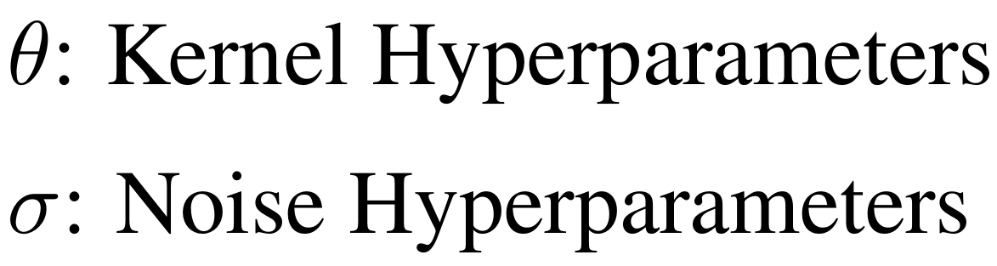
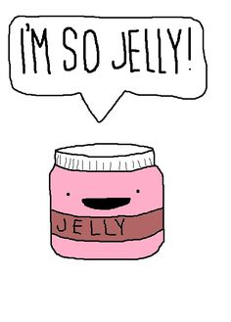
The envious success of Gaussian processes
Notes:
Many of you would be familiar with how hyperparameters are learned in a Gaussian process. They are done by minimizing the negative log marginal likelihood, shown here. And it works phenomenally.

Slide 20
The envious success of Gaussian processes
Negative
Log Marginal Likelihood
Data Fit Error
Model Complexity
Just Chilling…
Notes:
If you break it down, the negative log marginal likelihood balances two things – the data fit error and the model complexity. This balance is so critical when it comes to generalizing our model to unseen areas, and it provides two semantically different quantities that are useful for debugging how a model is learning. By doing this, you will end up getting the fit shown in the middle.
This awesome marginal likelihood is a product of the Bayesian formulation of Gaussian process regressors. Unfortunately, conditional mean embeddings are not necessarily Bayesian, so they do not have a natural marginal likelihood quantity just yet. That definitely makes us very jelly of Gaussian processes.
However, this is for regression. We want to do this for classification. Unfortunately, Gaussian process classification has several problems. Both the posterior and marginal likelihood cannot be exactly computed so it must be approximated. Also, it is formulated only for binary classification. Multiclass extensions usually involves combining many separate binary classifiers. There is no guarantee that this is optimal or even if the output is coherent. This is a similar story for other kernel based classifiers, and the situation is worse because often they don’t even have marginal likelihoods for hyperparameter learning!

Slide 21
The Research Question
Can Conditional Mean Embeddings (CMEs) be as cool as Gaussian Processes (GPs)?
Notes:
So, this leads us to the question,
Can conditional mean embeddings be as cool as Gaussian processes?

Slide 22
The Research Question
Can Conditional Mean Embeddings (CMEs) be as cool as Gaussian Processes (GPs)?
Can we design a hyperparameter learning objective for CMEs to ensure good generalization?
Notes:
More specifically, can we design a hyperparameter learning objective for conditional mean embeddings to ensure good generalization?

Slide 23
The Research Question
Can Conditional Mean Embeddings (CMEs) be as cool as Gaussian Processes (GPs)?
Can we design a hyperparameter learning objective for CMEs to ensure good generalization?
Balance Data Fit and Model Complexity
Scalable
Notes:
And given what we have just seen, can we do this in a way that balances data fit and model complexity? And can we do this in a way that is scalable?

Slide 24
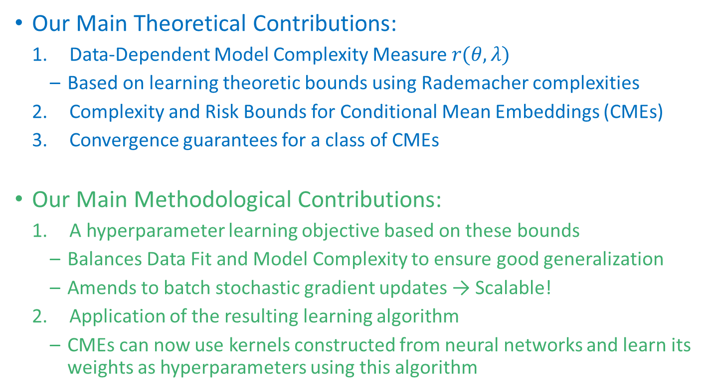
Yes we can!
Our Main Theoretical Contributions:
Data-Dependent Model Complexity Measure $r(θ,λ)$
Based on learning theoretic bounds using Rademacher complexities
Complexity and Risk Bounds for Conditional Mean Embeddings (CMEs)
Convergence guarantees for a class of CMEs
Our Main Methodological Contributions:
A hyperparameter learning objective based on these bounds
Balances Data Fit and Model Complexity to ensure good generalization
Amends to batch stochastic gradient updates → Scalable!
Application of the resulting learning algorithm
CMEs can now use kernels constructed from neural networks and learn its weights as hyperparameters using this algorithm
Notes:
The answer is yes we can!

Slide 25
Remainder of this Talk
Introduction – Background – Contributions – Experiments
Motivation
Research Question
Summary of Contribution
Overview of Kernel Mean Embeddings
Overview of Conditional Mean Embeddings
Multiclass Conditional Embedding
Hyperparameter Learning for Multiclass Conditional Embedding
Experiments: Toy Data, UCI Data, MNIST
Extension: Learning Neural Network Weights as Hyperparameters

Slide 26
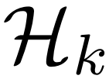
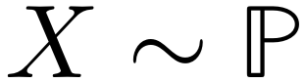
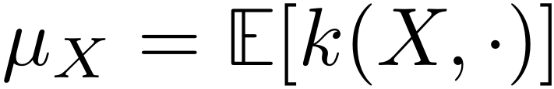
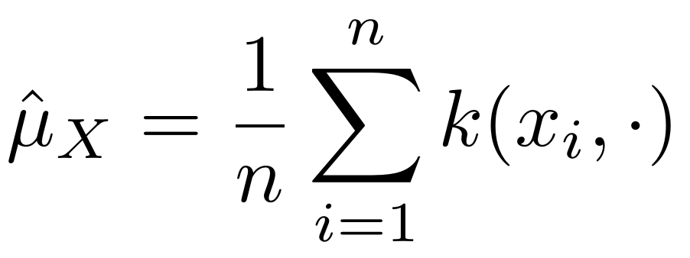
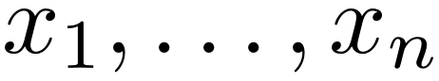
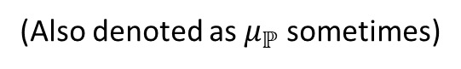
Kernel Mean Embeddings
Reproducing Kernel Hilbert Space (RKHS)
Mean Embedding
(Also denoted as $μ_{ℙ}$ sometimes)
Empirical Mean Embedding
Notes:
Have a motivation
So, what are kernel mean embeddings?
Simply put, kernel mean embeddings are a class of models that

Slide 27
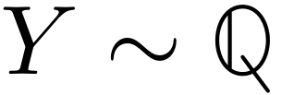
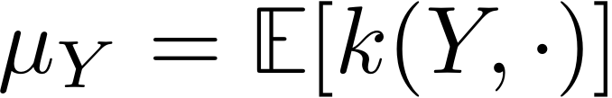
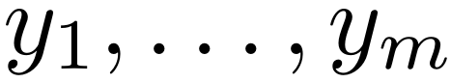
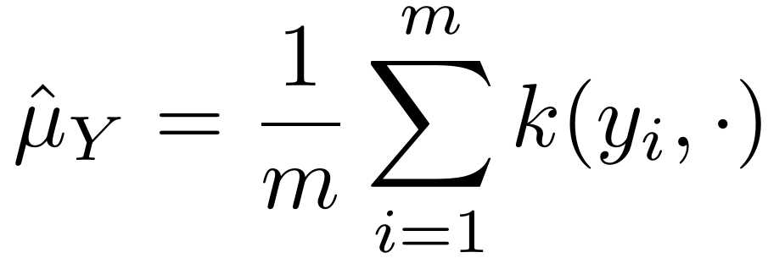
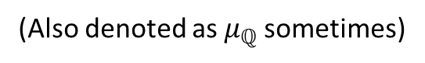
Kernel Mean Embeddings
Reproducing Kernel Hilbert Space (RKHS)
Mean Embedding
(Also denoted as $μ_{ℚ}$sometimes)
Empirical Mean Embedding

Slide 28
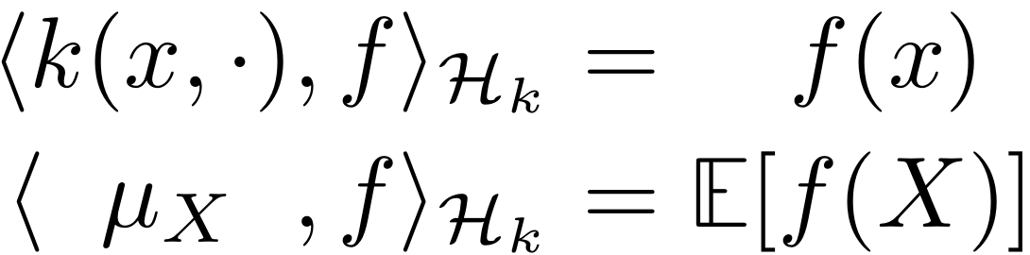
Kernel Mean Embeddings
Reproducing Kernel Hilbert Space (RKHS)
Mean Embedding
Empirical Mean Embedding
Reproducing Property:
They encode expectations:

Slide 29
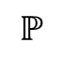

Kernel Mean Embeddings
$$ℙ$$
Marginalisation Integrals
$$ℚ$$
Notes:
And why is this property so useful?

Slide 30

Kernel Mean Embeddings
$$ℙ$$
Marginalisation Integrals
$$ℚ$$

Slide 31
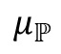
Kernel Mean Embeddings
Reproducing Kernel Hilbert Space (RKHS)
$$ℙ$$
Embed Into RKHS
$$μ_{ℙ}$$
Marginalisation Integrals
$$ℚ$$

Slide 32
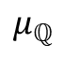
Kernel Mean Embeddings
Reproducing Kernel Hilbert Space (RKHS)
$$ℙ$$
Embed Into RKHS
$$μ_{ℙ}$$
Marginalisation Integrals
Linear Operations
$$μ_{ℚ}$$
$$ℚ$$

Slide 33
Kernel Mean Embeddings
Reproducing Kernel Hilbert Space (RKHS)
$$ℙ$$
Embed Into RKHS
$$μ_{ℙ}$$
Marginalisation Integrals
Linear Operations
$$μ_{ℚ}$$
$$ℚ$$
Convert back into
distributions

Slide 34
Kernel Mean Embeddings
Reproducing Kernel Hilbert Space (RKHS)
$$ℙ$$
Embed Into RKHS
$$μ_{ℙ}$$
Marginalisation Integrals
Linear Operations
Too hard!
$$μ_{ℚ}$$
$$ℚ$$
Convert back into
distributions

Slide 35
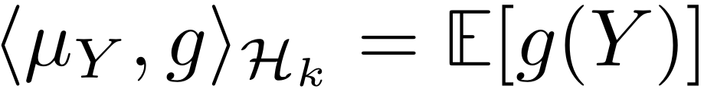
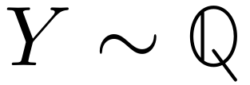
Kernel Mean Embeddings
Reproducing Kernel Hilbert Space (RKHS)
$$ℙ$$
Embed Into RKHS
$$μ_{ℙ}$$
Marginalisation Integrals
Linear Operations
Too hard!
$$μ_{ℚ}$$
$$ℚ$$
Convert back into
distributions

Slide 36

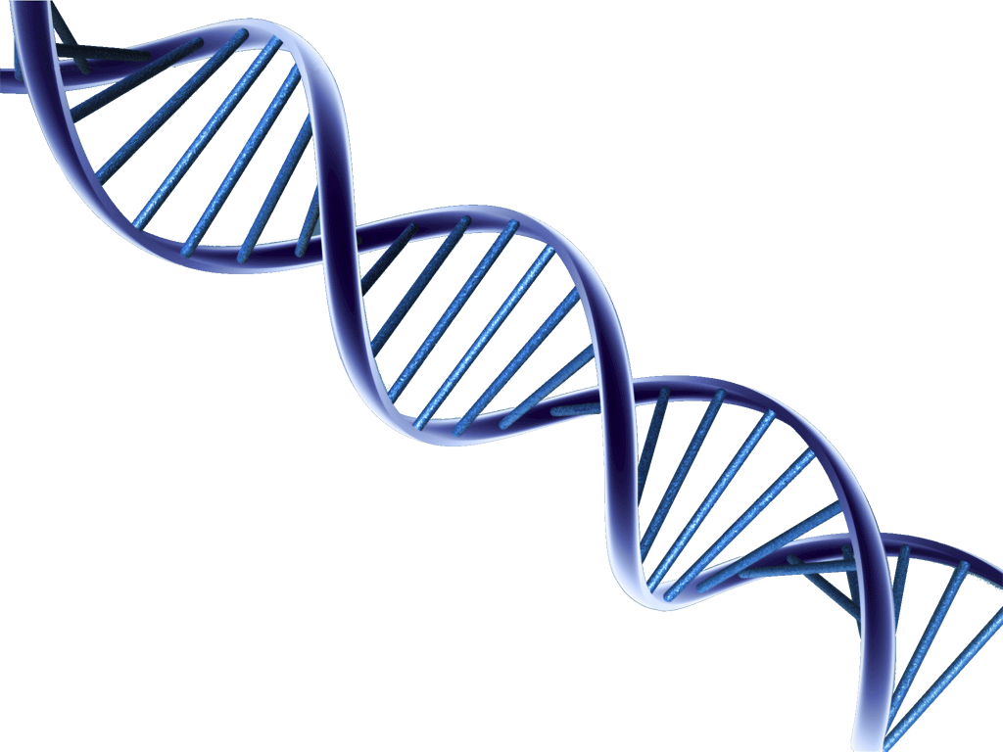



Kernel Mean Embeddings (Analogy)
Analogy:
Space of distributions → Space of humans
RKHS → Space of DNAs
Space of DNAs
Extract DNA
Train Hard
Work Hard
Level Up
DNA Manipulations
Convert back to human

Slide 37
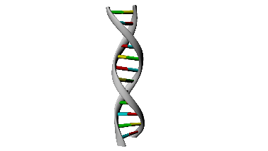


Kernel Mean Embeddings (Analogy)
Problem: The RKHS (analogy: space of DNAs) is richer and bigger than the space of distributions (analogy: space of humans)
Space of DNAs
Extract DNA
No matter how much Charlie trains, he will never become a monster
A different but still valid
DNA Manipulation
Convert back to… human?

Slide 38
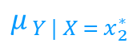
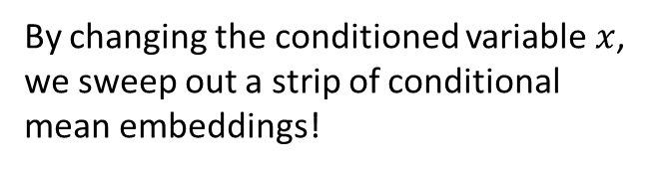
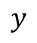
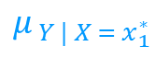
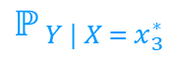
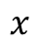
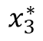
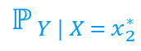
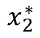
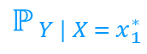


Conditional Mean Embeddings
By changing the conditioned variable $x$, we sweep out a strip of conditional mean embeddings!
Reproducing Kernel Hilbert Space (RKHS)
$$μ_{ Y | X = x_{1}^{∗}}$$
$$ℙ_{ Y | X = x_{1}^{∗}}$$
$$ℙ_{ Y | X = x_{2}^{∗}}$$
$$ℙ_{ Y | X = x_{3}^{∗}}$$
$$y$$
$$μ_{ Y | X = x_{2}^{∗}}$$
$$μ_{ Y | X = x_{3}^{∗}}$$
$$x_{1}^{∗}$$
$$x_{2}^{∗}$$
$$x_{3}^{∗}$$
$$x$$

Slide 39



Conditional Mean Embeddings
How do we get empirical estimates for CMEs?
Reproducing Kernel Hilbert Space (RKHS)
$$μ_{ Y | X = x_{1}^{∗}}$$
$${\hat{μ}}_{ Y | X = x_{1}^{∗}}$$
$$ℙ_{ Y | X = x_{1}^{∗}}$$
$$ℙ_{ Y | X = x_{2}^{∗}}$$
$$ℙ_{ Y | X = x_{3}^{∗}}$$
$$y$$
$${\hat{μ}}_{ Y | X = x_{2}^{∗}}$$
$$μ_{ Y | X = x_{2}^{∗}}$$
$${\hat{μ}}_{ Y | X = x_{3}^{∗}}$$
$$μ_{ Y | X = x_{3}^{∗}}$$
$$x_{1}^{∗}$$
$$x_{2}^{∗}$$
$$x_{3}^{∗}$$
$$x$$

Slide 40
Conditional Mean Embeddings
In practice, we don’t have this…
Reproducing Kernel Hilbert Space (RKHS)
$$μ_{ Y | X = x_{1}^{∗}}$$
$${\hat{μ}}_{ Y | X = x_{1}^{∗}}$$
$$ℙ_{ Y | X = x_{1}^{∗}}$$
$$ℙ_{ Y | X = x_{2}^{∗}}$$
$$ℙ_{ Y | X = x_{3}^{∗}}$$
$$y$$
$${\hat{μ}}_{ Y | X = x_{2}^{∗}}$$
$$μ_{ Y | X = x_{2}^{∗}}$$
$${\hat{μ}}_{ Y | X = x_{3}^{∗}}$$
$$μ_{ Y | X = x_{3}^{∗}}$$
$$x_{1}^{∗}$$
$$x_{2}^{∗}$$
$$x_{3}^{∗}$$
$$x$$

Slide 41
Conditional Mean Embeddings
Instead, we have this…
Reproducing Kernel Hilbert Space (RKHS)
$$μ_{ Y | X = x_{1}^{∗}}$$
$${\hat{μ}}_{ Y | X = x_{1}^{∗}}$$
$$ℙ_{ Y | X = x_{1}^{∗}}$$
$$ℙ_{ Y | X = x_{2}^{∗}}$$
$$ℙ_{ Y | X = x_{3}^{∗}}$$
$$y$$
$${\hat{μ}}_{ Y | X = x_{2}^{∗}}$$
$$μ_{ Y | X = x_{2}^{∗}}$$
$${\hat{μ}}_{ Y | X = x_{3}^{∗}}$$
$$μ_{ Y | X = x_{3}^{∗}}$$
$$x_{1}^{∗}$$
$$x_{2}^{∗}$$
$$x_{3}^{∗}$$
$$x$$

Slide 42
Conditional Mean Embeddings
The entire strip of conditional mean embeddings are estimated at once from the same joint samples!
Reproducing Kernel Hilbert Space (RKHS)
$$μ_{ Y | X = x_{1}^{∗}}$$
$${\hat{μ}}_{ Y | X = x_{1}^{∗}}$$
$$ℙ_{ Y | X = x_{1}^{∗}}$$
$$ℙ_{ Y | X = x_{2}^{∗}}$$
$$ℙ_{ Y | X = x_{3}^{∗}}$$
$$y$$
$${\hat{μ}}_{ Y | X = x_{2}^{∗}}$$
$$μ_{ Y | X = x_{2}^{∗}}$$
$${\hat{μ}}_{ Y | X = x_{3}^{∗}}$$
$$μ_{ Y | X = x_{3}^{∗}}$$
$$x_{1}^{∗}$$
$$x_{2}^{∗}$$
$$x_{3}^{∗}$$
$$x$$

Slide 43


Using conditional mean embeddings to approximate conditional expectations
Goal: Approximate $𝔼\left[g\left(Y\right) | X=x\right]$ for some function $g$
You need:
Joint samples ${\left\{x_{i},y_{i}\right\}}_{i=1}^{n}$ and a query input $x$
A kernel for the input $k\left(x, x^{′}\right)$and for the output $l\left(y, y^{′}\right)$
The empirical conditional mean embedding is
To approximate conditional expectations, use inner product!
Notes:
How to construct a conditional mean embedding:
You need input and output kernel
You have data points (pair)
You have a query point x
The empirical CME is given by…
To find expectations, you do a dot product

Slide 44



Multiclass Conditional Embeddings: Using conditional means for classification
So far both inputs and outputs can be arbitrary
Let output be categorical: $𝒴=\left\{1, 2, …, m\right\}$
Inputs can still be arbitrary: $𝒳=$ anything
The decision probability for class $c$ for an input example $x$ is
So, if we use ,
Notes:
Emphasize more on the discrete output part

Slide 45


Multiclass Conditional Embeddings: Using conditional means for classification
So far both inputs and outputs can be arbitrary
Let output be categorical: $𝒴=\left\{1, 2, …, m\right\}$
Inputs can still be arbitrary: $𝒳=$ anything
The decision probability for class $c$ for an input example $x$ is
So, if we use ,
Theorem: Multiclass conditional embeddings are consistent probability estimates
Notes:
Emphasize more on the discrete output part

Slide 46

Multiclass Conditional Embeddings are consistent probability estimates (analogy)
Space of DNAs
Extract DNA
DNA Manipulation
With more data, the monsters will converge to superman

Slide 47

Loss for probabilistic classification
Use cross entropy loss instead of square loss
Has theoretical connections to MLE and KL minimization of optimal classifiers
Has good empirical performance
In order to derive learning theoretic bounds, it needs to be bounded:
Notes:
Emphasize more on the discrete output part

Slide 48

Rademacher Complexities
Data-Dependent Complexity of Function Classes
Measures ability to shatter noise:
Normally used to constrain the function class within which training of model parameters is conducted
Not usually used as part of an objective
Not usually used for hyperparameter learning either
It measures complexity of function classes, not individual functions – we need to do some work to make it work for hyperparameter learning
Notes:
Put RC equation

Slide 49

The main result
For the multiclass cross entropy loss, the expected risk has an expected risk bound that is the sum of:
A data fit error term
A model complexity term
Some statistical junk
Notes:
This sounds familiar!

Slide 50

The learning objective
We show that the expected risk has an upper bound that is the sum of:
A data fit error term
A model complexity term
Some statistical junk
Notes:
This sounds familiar!

Slide 51
Batch Stochastic Gradient Updates
We show that the expected risk has an upper bound that is the sum of:
A data fit error term
A model complexity term
Some statistical junk
Notes:
This sounds familiar!

Slide 52

Learning Algorithm

Slide 53






















Conditional Embedding Network
$$k\left(x, x^{′}\right)→\tilde{k} (φ\left(x\right), φ\left(x^{′}\right))$$
Use a neural network here
$$x_{1}$$
$$φ^{1}(x)$$
$$x$$
$$⋮$$
$$⋮$$
$$φ\left(x\right)$$
$$φ^{p}(x)$$
$$x_{d}$$
$$\tilde{k}$$
$$x_{1}^{′}$$
$$φ^{1}(x^{′})$$
The kernel hyperparameters of $\tilde{k}$ and the neural network weights and biases of $φ$ now both become part of the kernel hyperparameters of $k$
$$x^{′}$$
$$⋮$$
$$⋮$$
$$φ\left(x^{′}\right)$$
$$φ^{p}(x^{′})$$
$$x_{d}^{′}$$

Slide 54

Toy Example: Three Tailed Spiral

Slide 55


Toy Example: Three Tailed Spiral

Slide 56


Toy Example: Non-Separable Iris
Initially Overfitted Model
Initially Underfitted Model

Slide 57



Toy Example: Non-Separable Iris
Initially Overfitted Model
Initially Underfitted Model

Slide 58
Toy Example: Non-Separable Iris
Initially Overfitted Model
Initially Underfitted Model

Slide 59

Benchmarking with UCI Datasets
Best Performing Algorithms Reported on the UCI repository

Slide 60


Learning MNIST Pixel Relevance

Slide 61

Conditional Embedding Network

Slide 62
Summary
Conditional mean embeddings provide a coherent and consistent model for multiclass probabilistic classification
But, like most kernel algorithms, hyperparameter learning is very difficult especially if you want to ensure good generalization
Using Rademacher complexities, we prove learning theoretic bounds for the generalization risk (expected loss)
We use these bounds to:
Derive a new data-dependent complexity measure, the Rademacher complexity bound (RCB) for particular hyperparameter choices
Propose a hyperparameter learning objective that balances data fit and model complexity
We extend the method to:
Only require batch stochastic gradient updates for learning
Learn deep neural network weights as hyperparameters

Slide 63
What I learned
Hyperparameter learning is very important! It is not enough to say “it converges in the limit of infinite data”.
Conditional mean embeddings are great in multiclass settings
Model complexity for particular choices of hyperparameters is crucial for both performance and interpretability
Learning theoretic bounds can be used to establish validity of batch stochastic gradient updates
Let us not see it as kernels v.s. neural networks – why not both?

Slide 64
Thank you!

